Slide 1
RepRap Evolution
Andy Kirby
&
Chris & Mary Palmer

Slide 2
Overview
Evolution of the RepRap and 3D printing
The Mendel90 Design
Uses of 3D printing

Slide 3
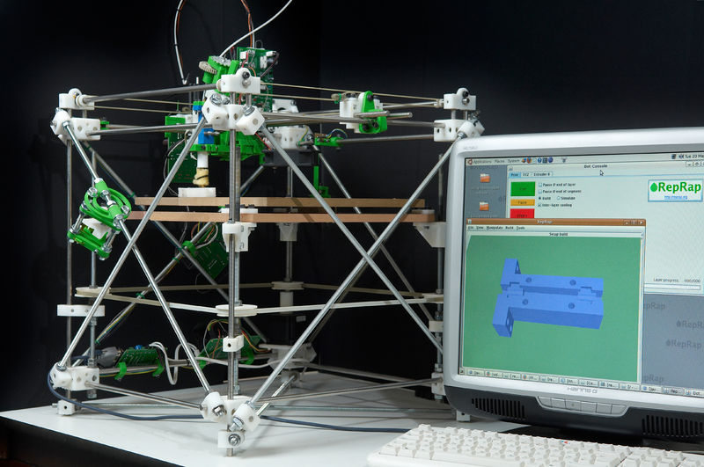
RepRap Origins
Original Darwin

Slide 4
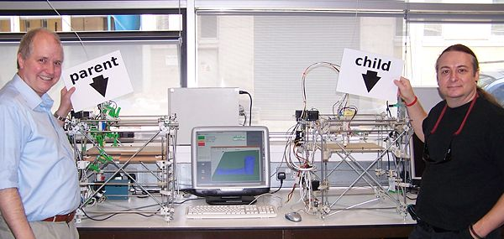
Adrian Bowyer – University of Bath

Slide 5
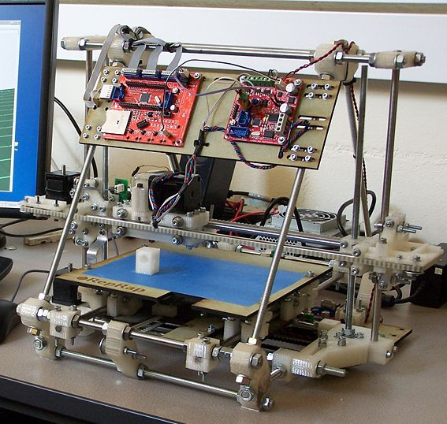
Original Mendel

Slide 6
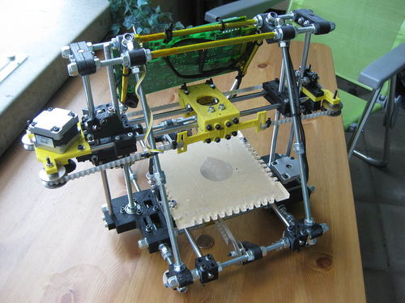
Original
Sells Huxley

Slide 7
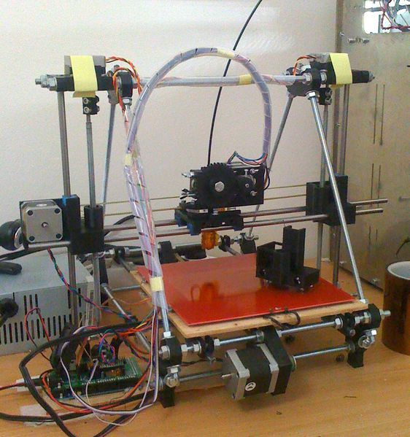
Prusa Mendel

Slide 8
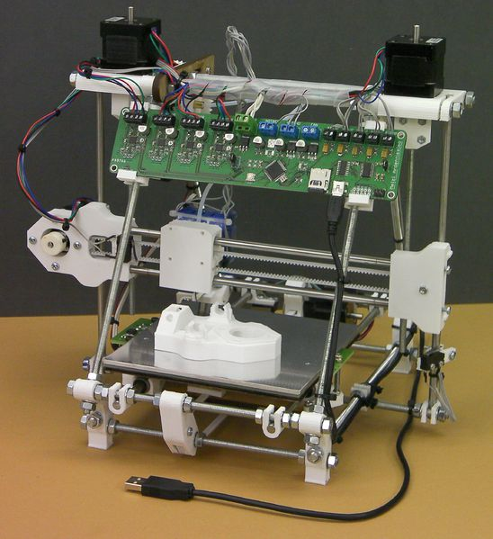
RepRap
Pro Huxley

Slide 9
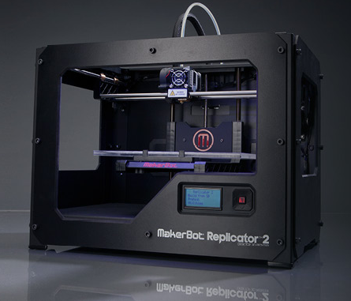
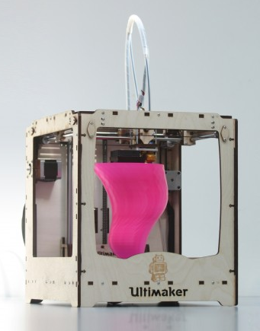
Commercial Machines
http://www.makerbot.com/
https://shop.ultimaker.com/en/

Slide 10
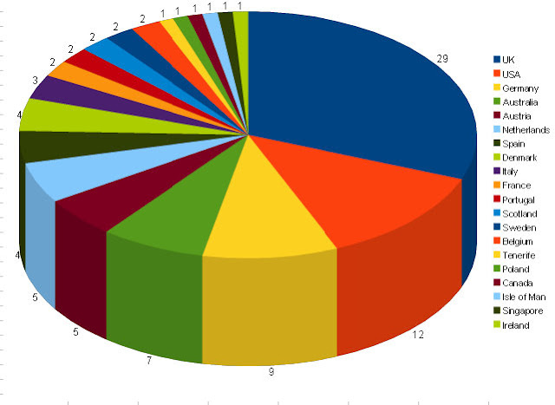
101 Mendels!
Up to Dec 2010

Slide 11
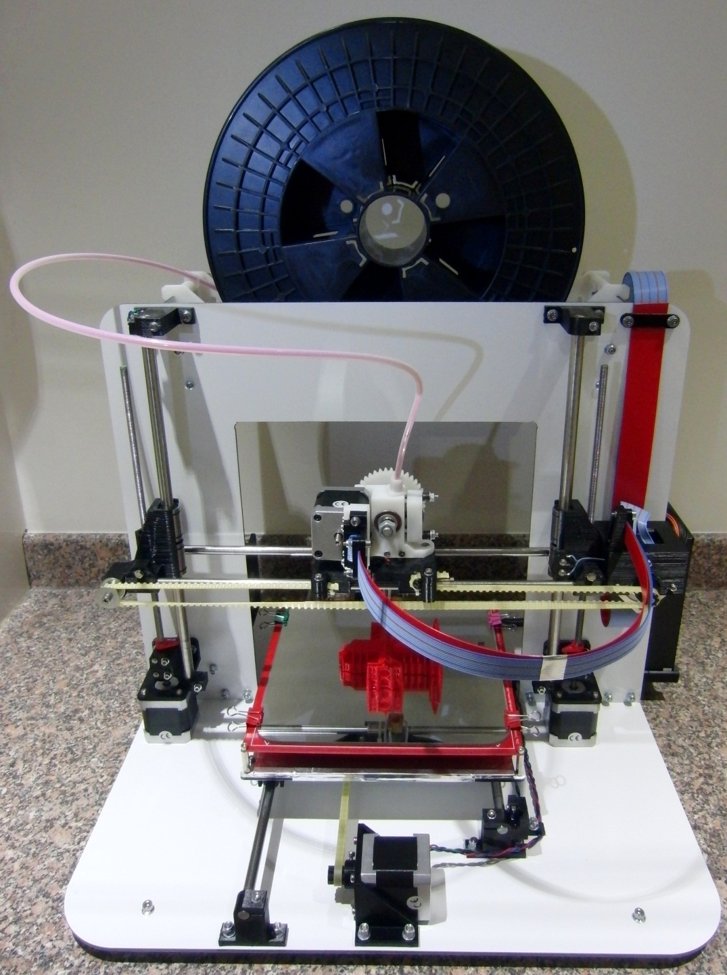
Mendel90

Slide 12
Mendel90
Optimised kit-based design
More suitable for entry level 3D printing
A robust solid structure
Self aligning
The result of evolutionary design

Slide 13
Uses of 3D Printing
Decorative pieces
Useful items
Fixing things
Unique structures
Engineered pieces

Slide 14
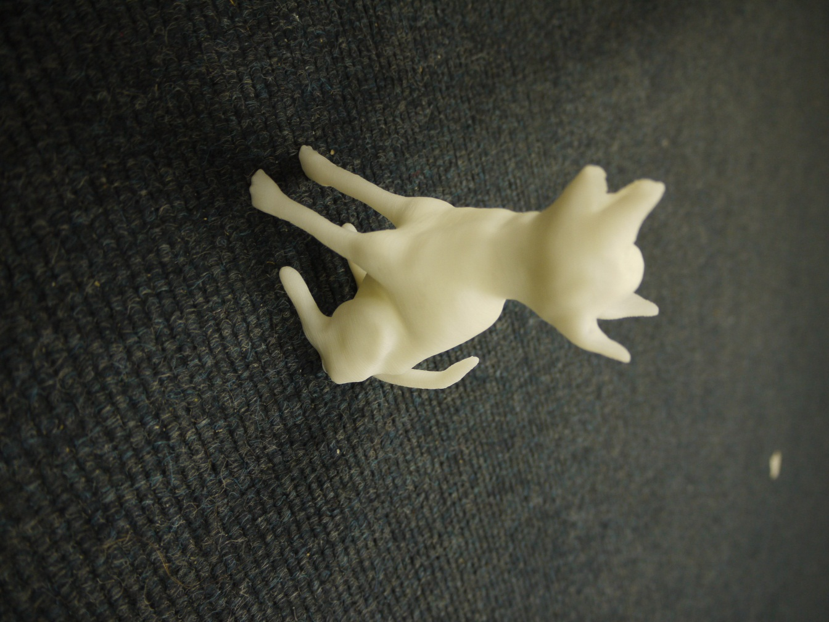
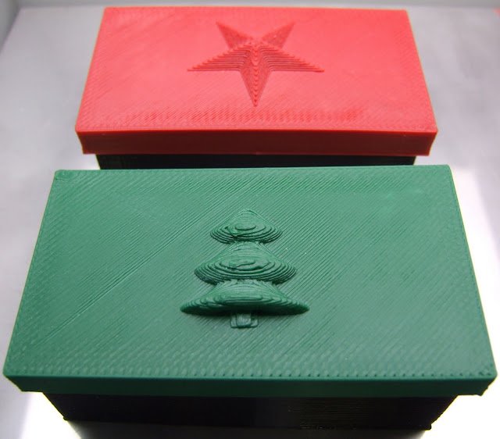
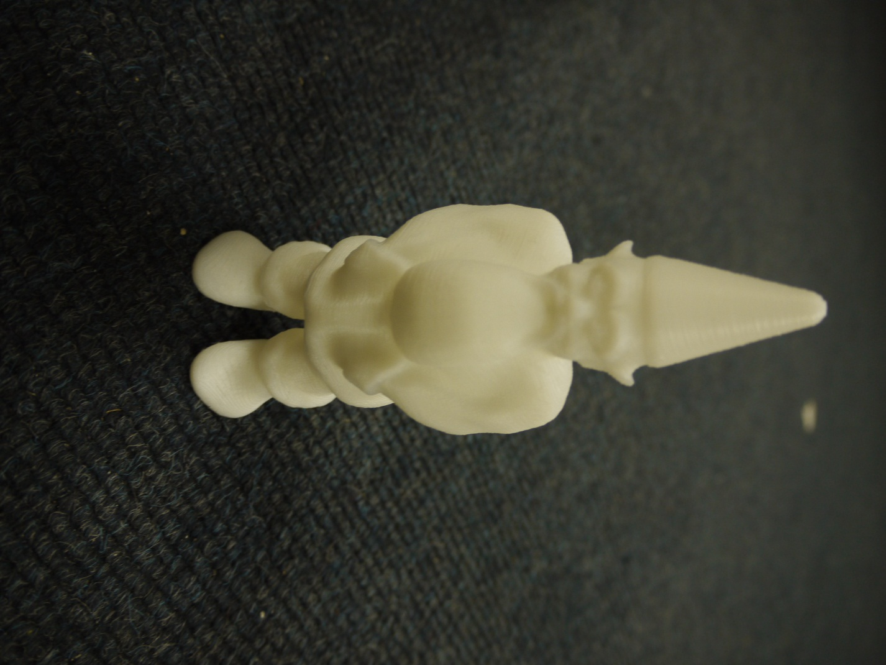
Decorative Pieces

Slide 15
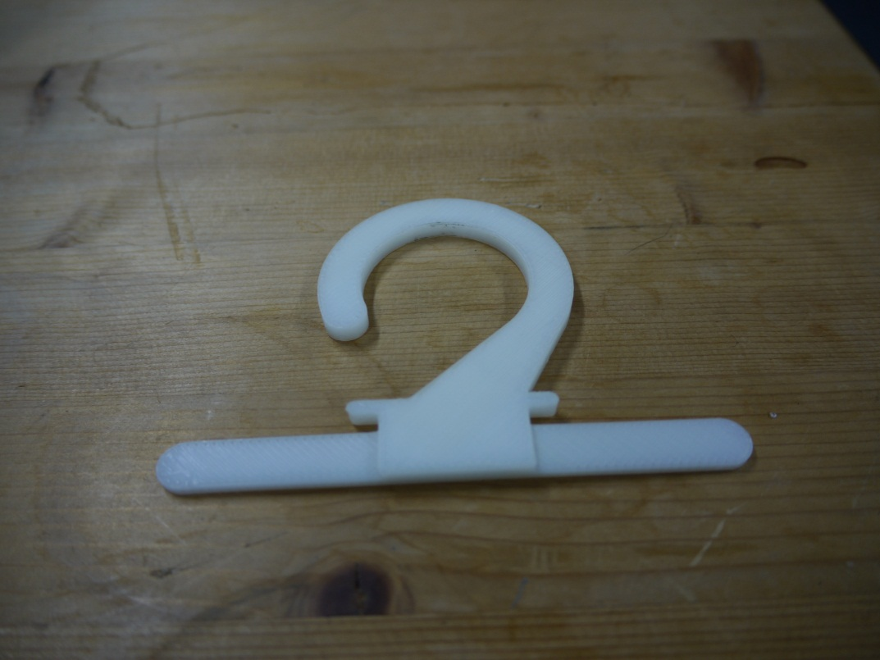
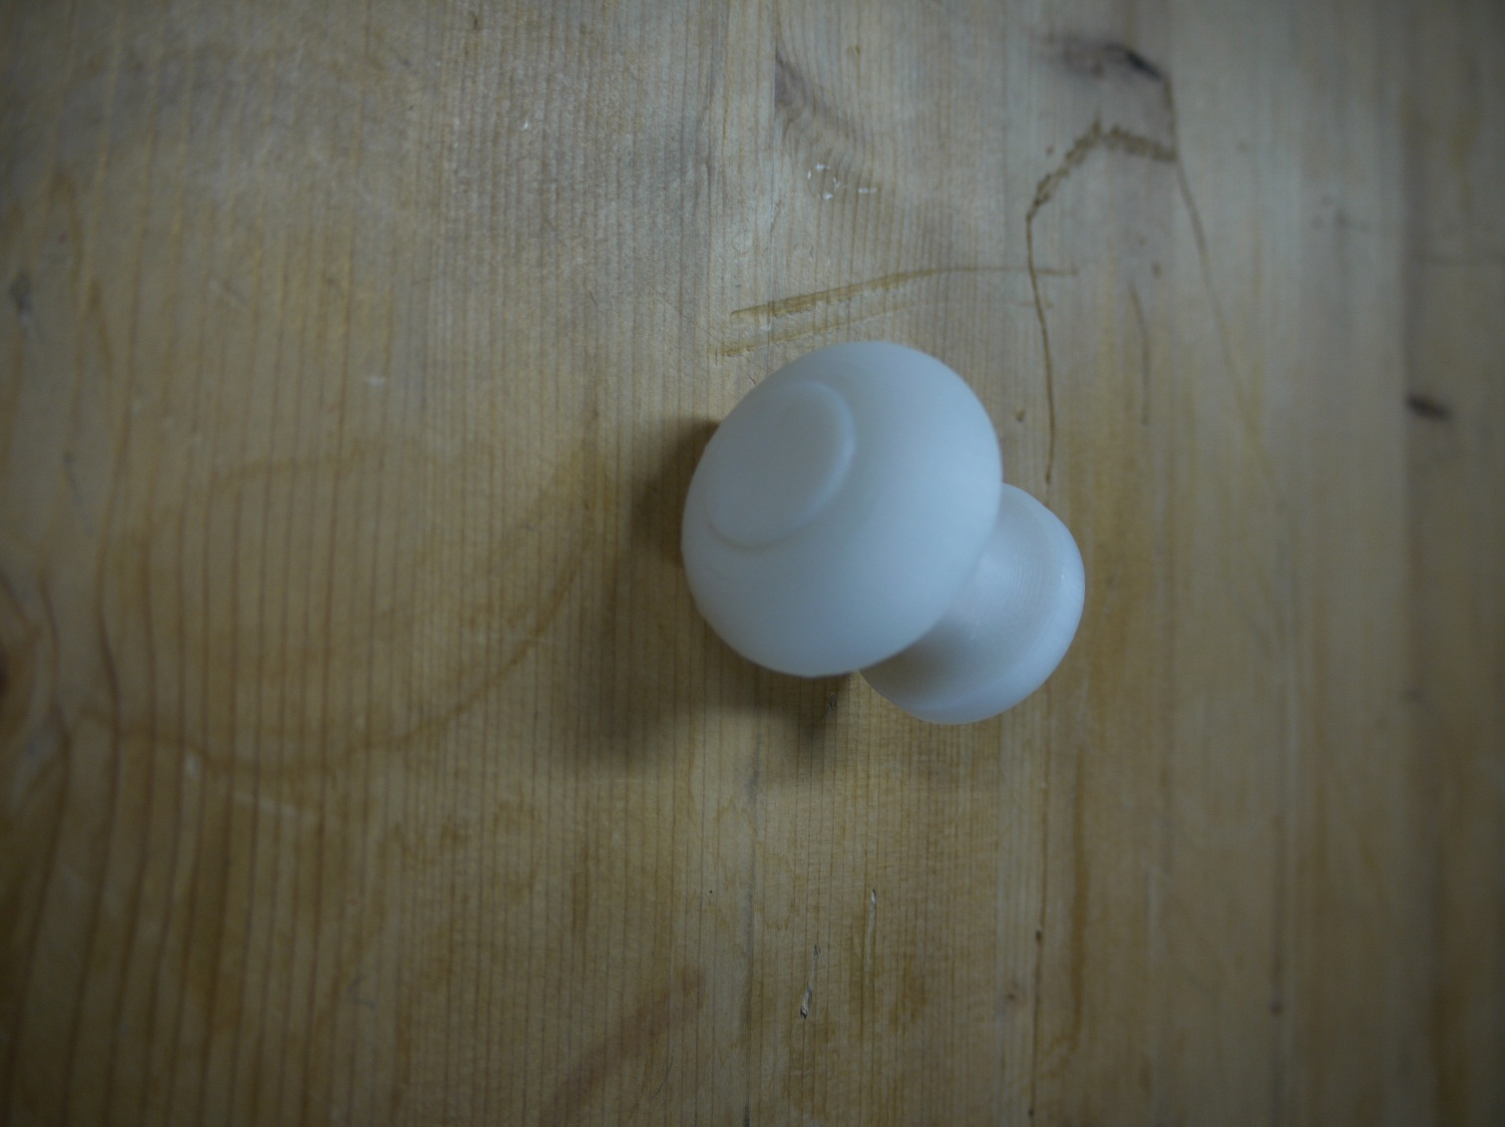
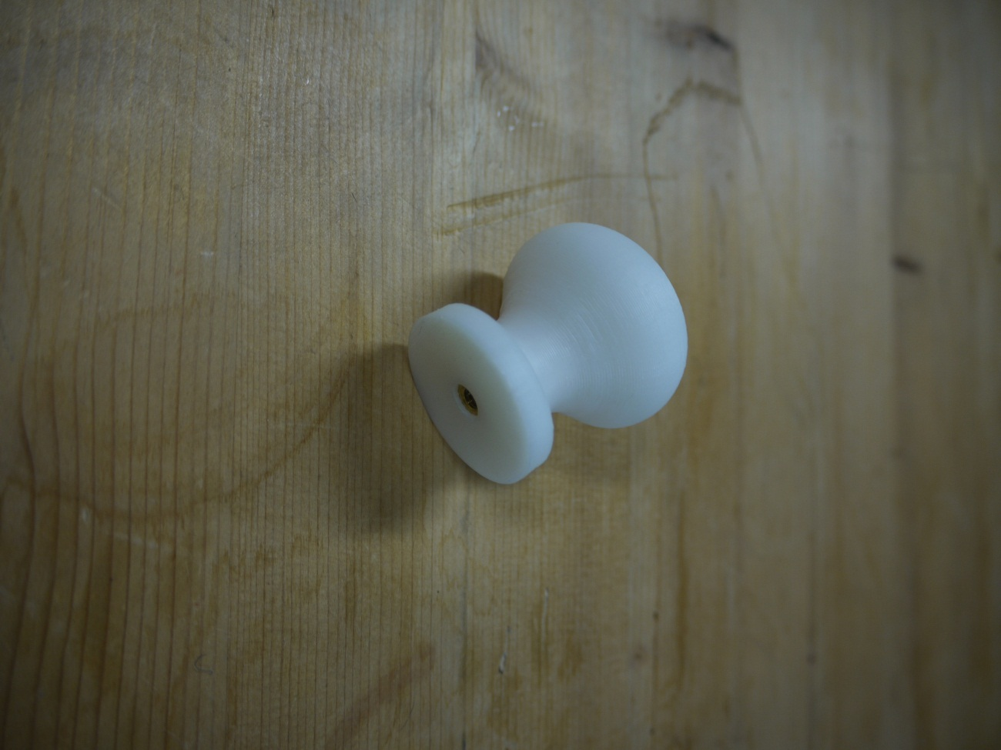
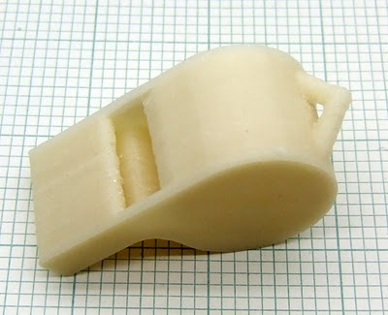
Useful Items

Slide 16
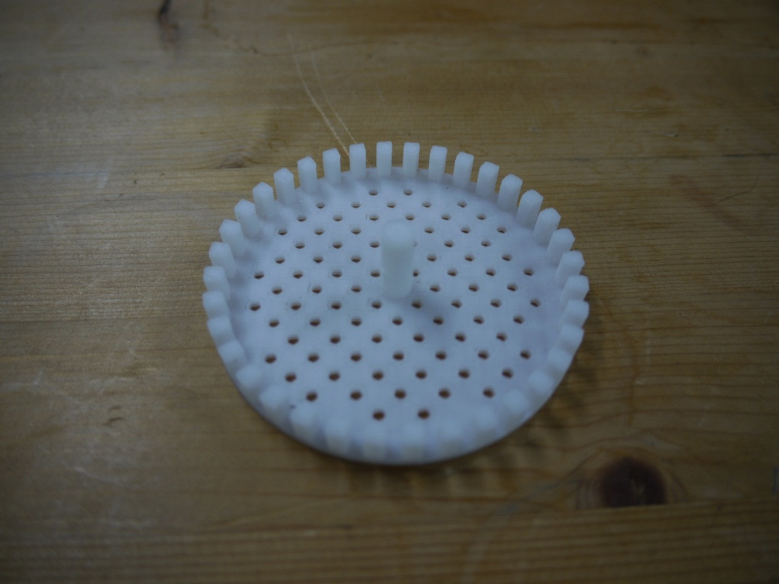
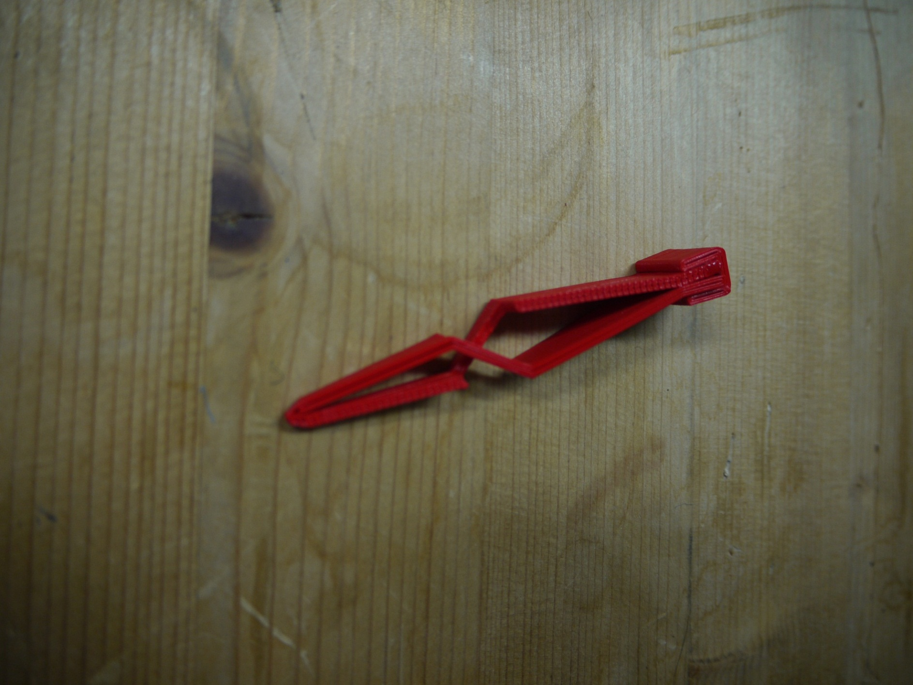
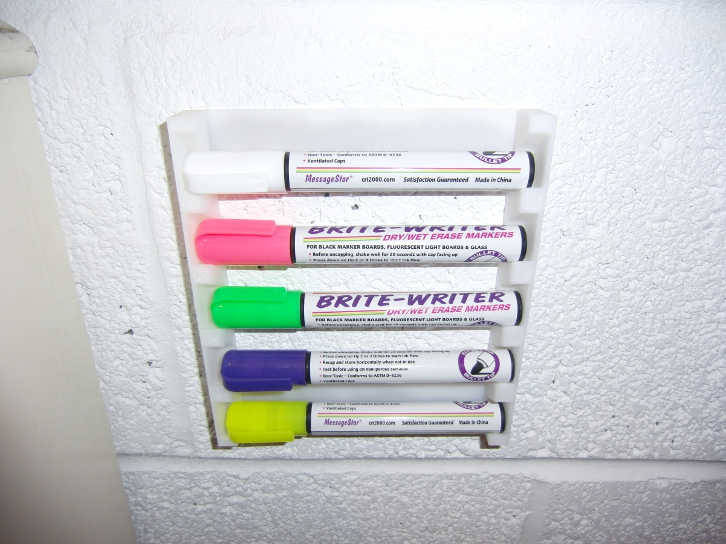
Useful Items

Slide 17
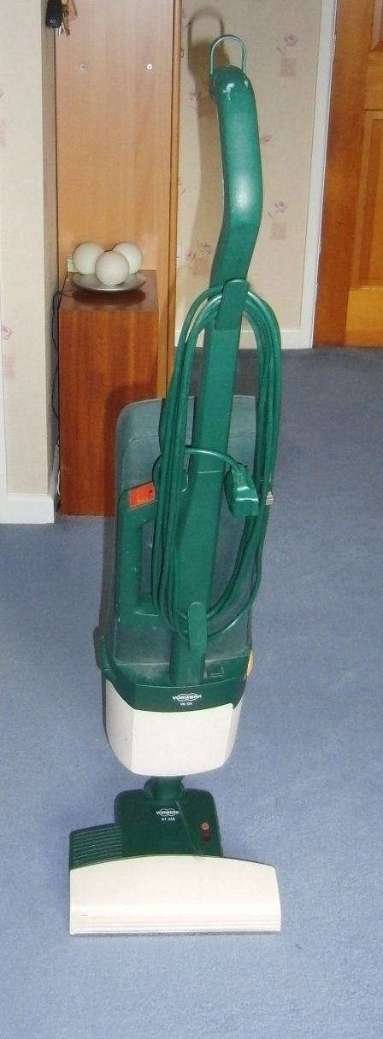
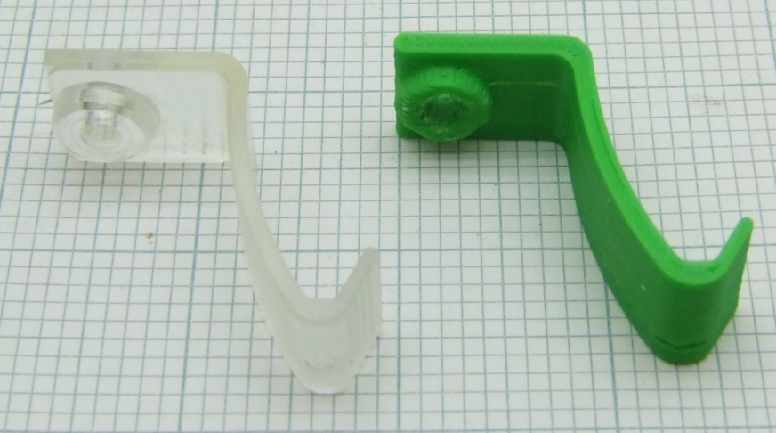
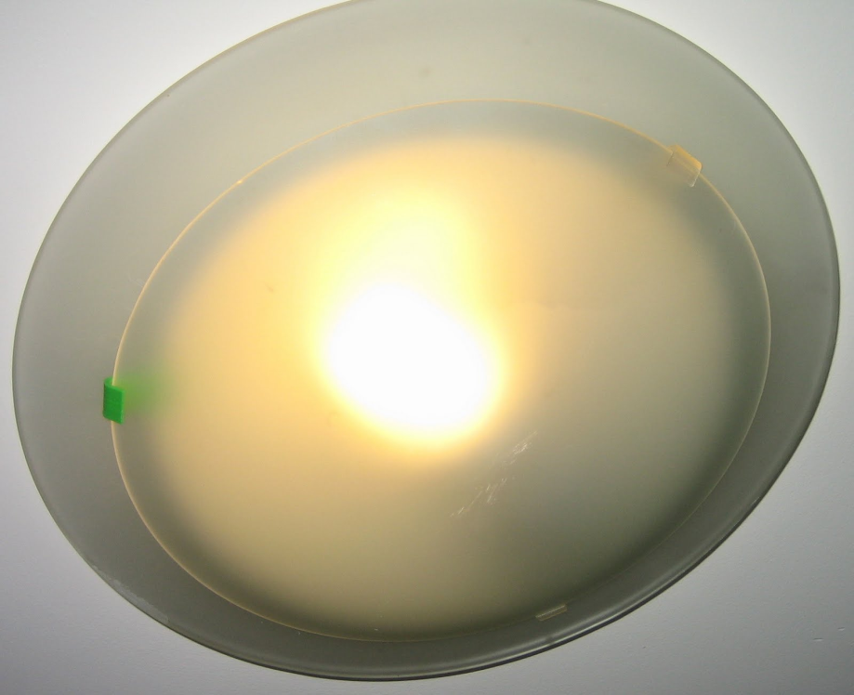
Fixing Things

Slide 18
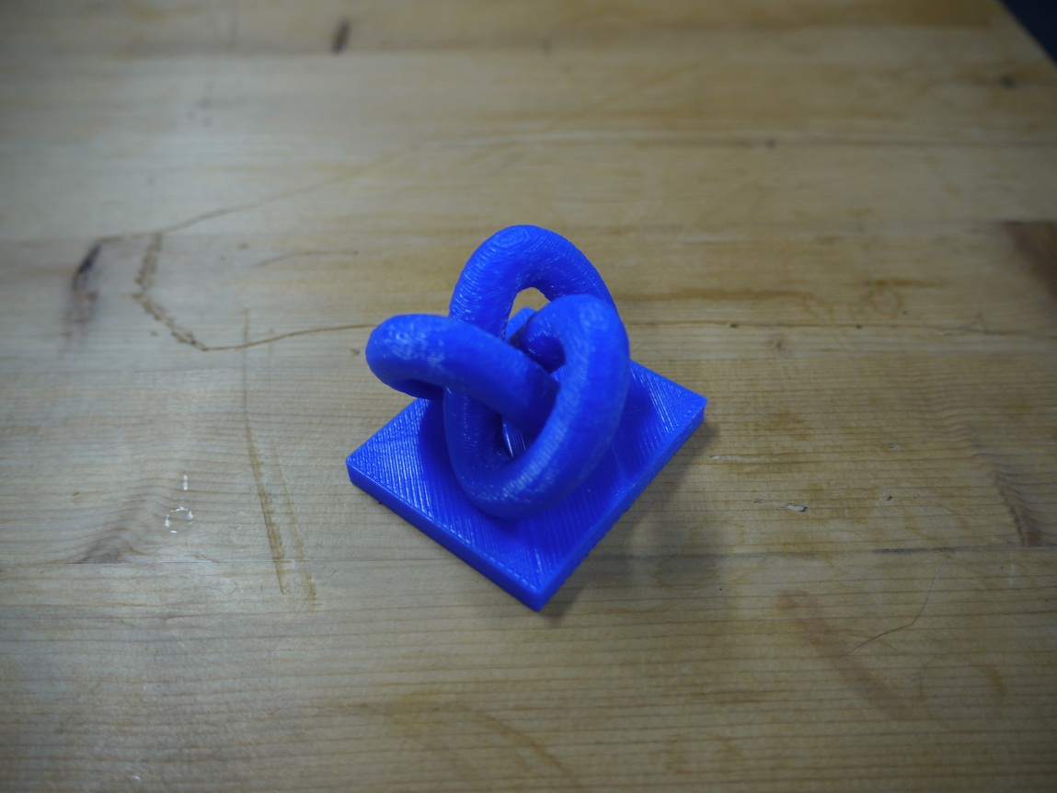
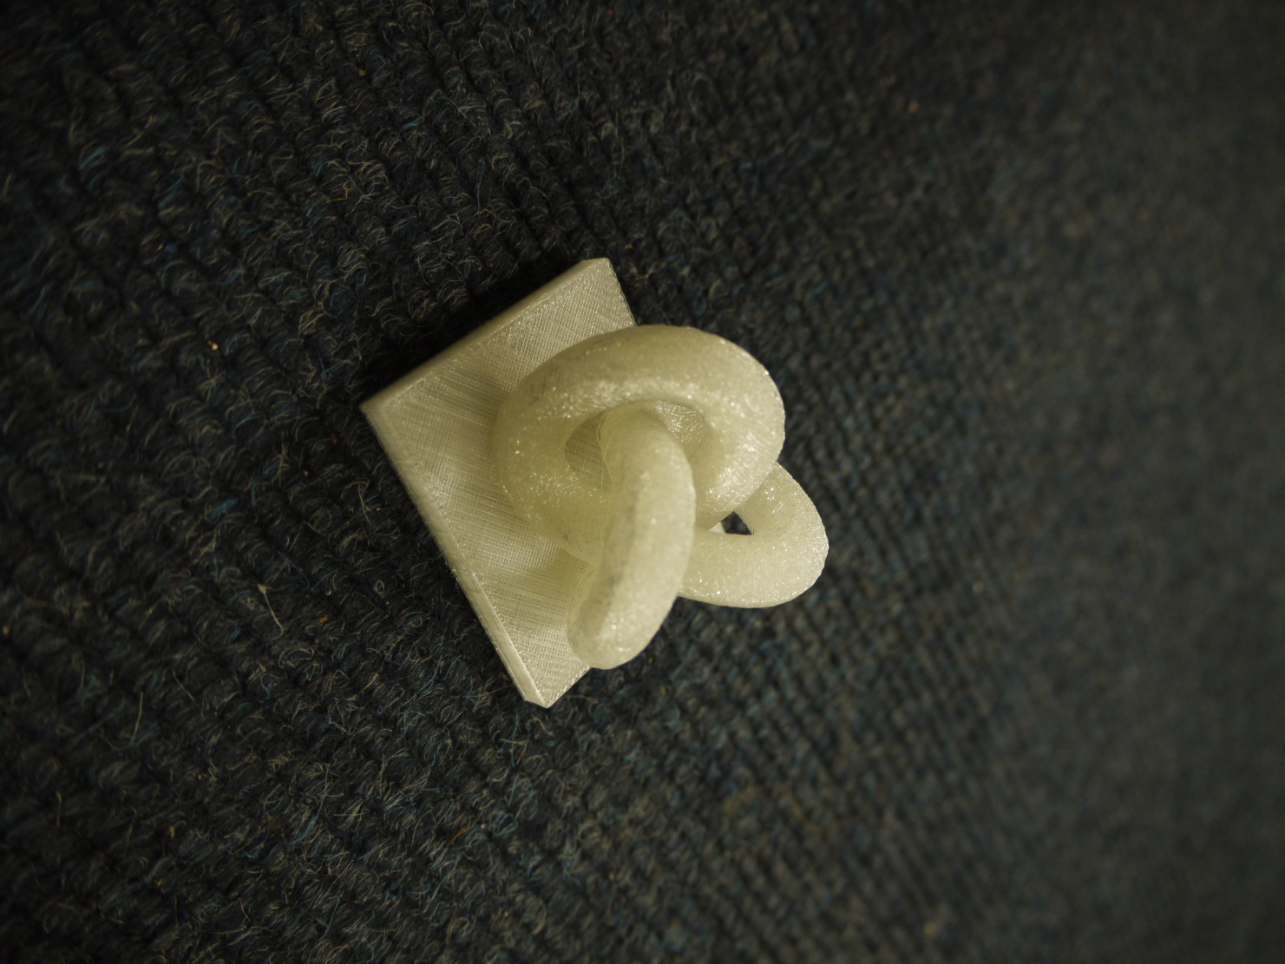
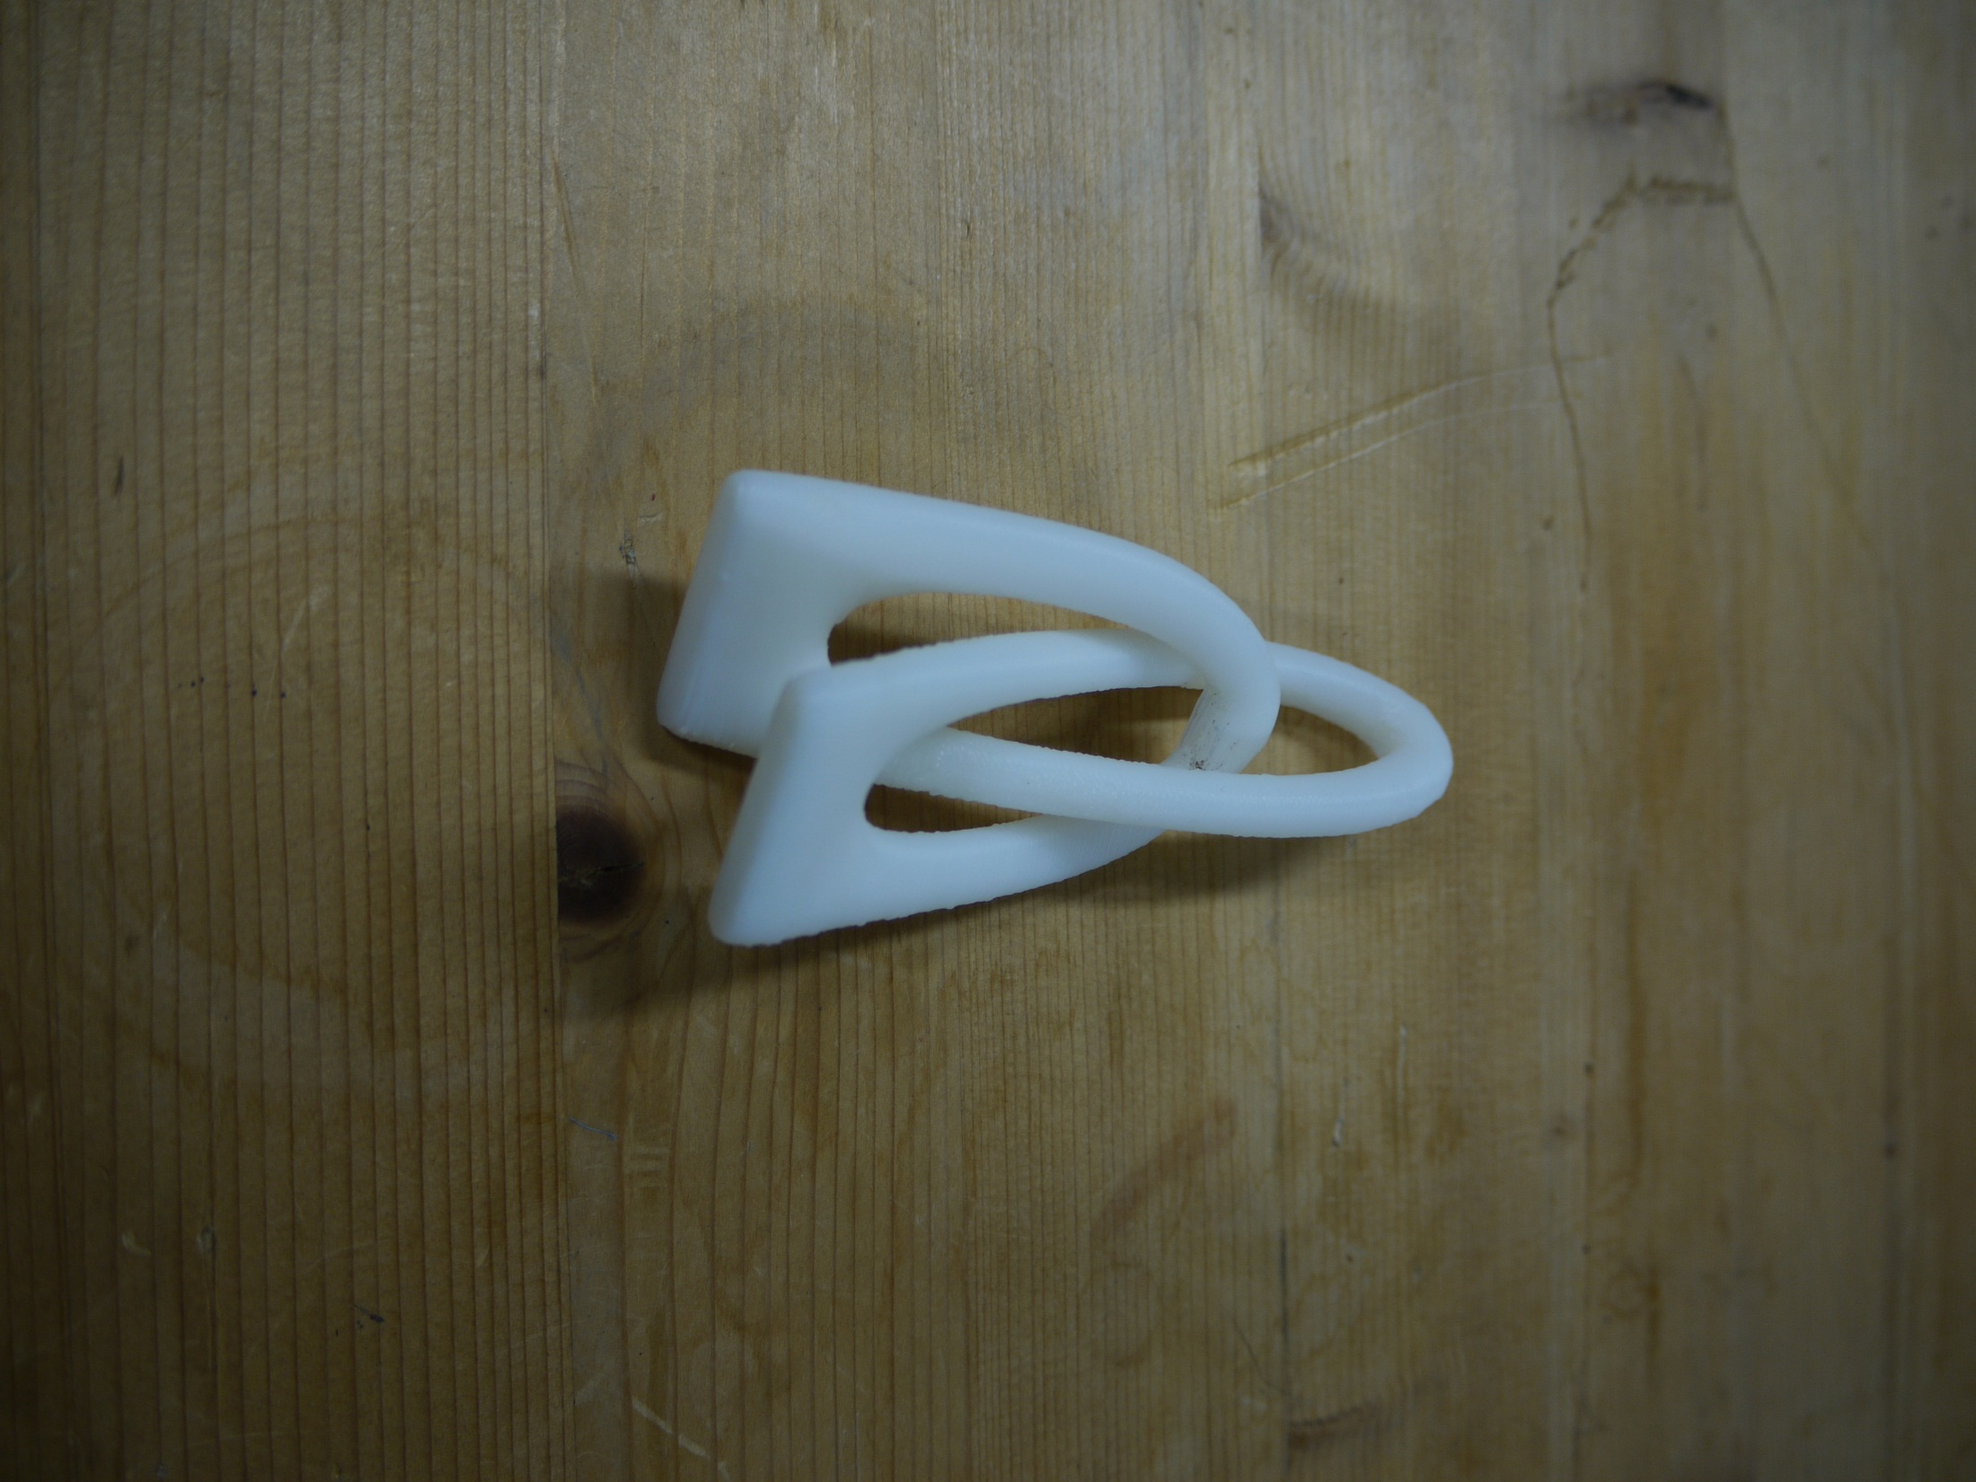
Unique Structures

Slide 19
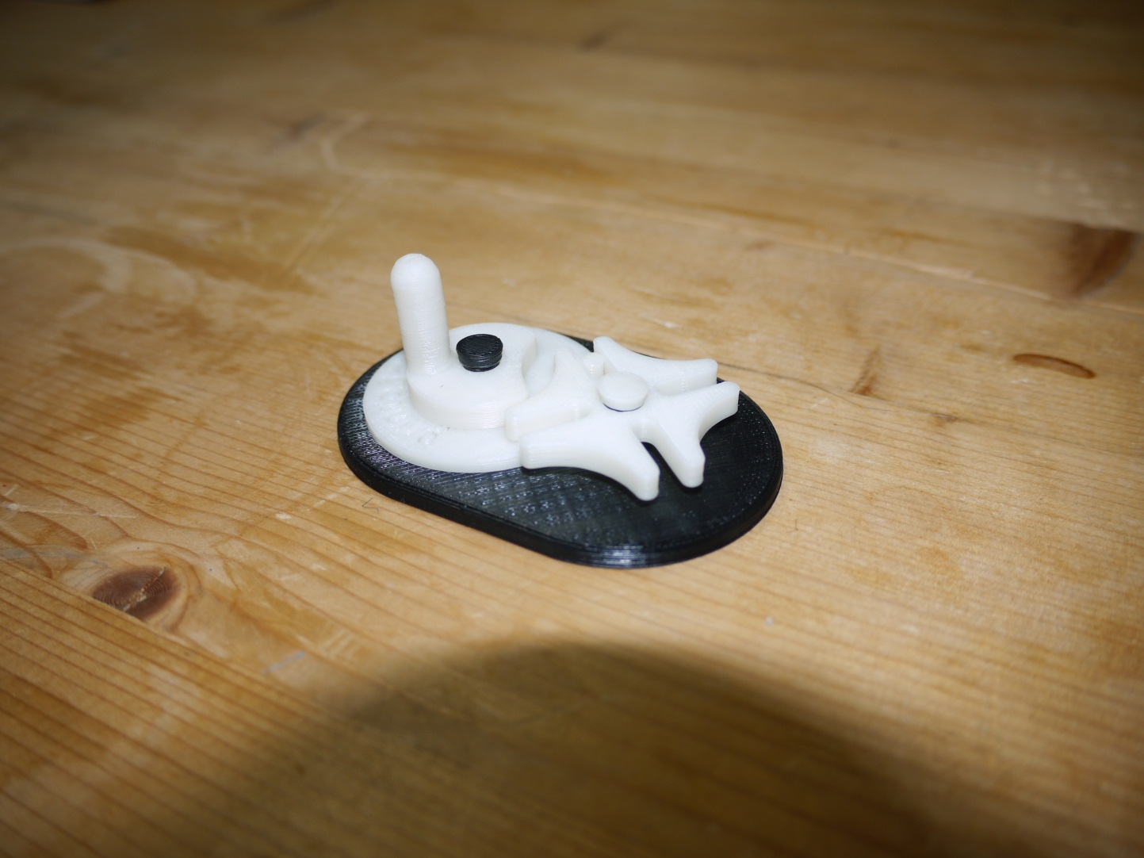
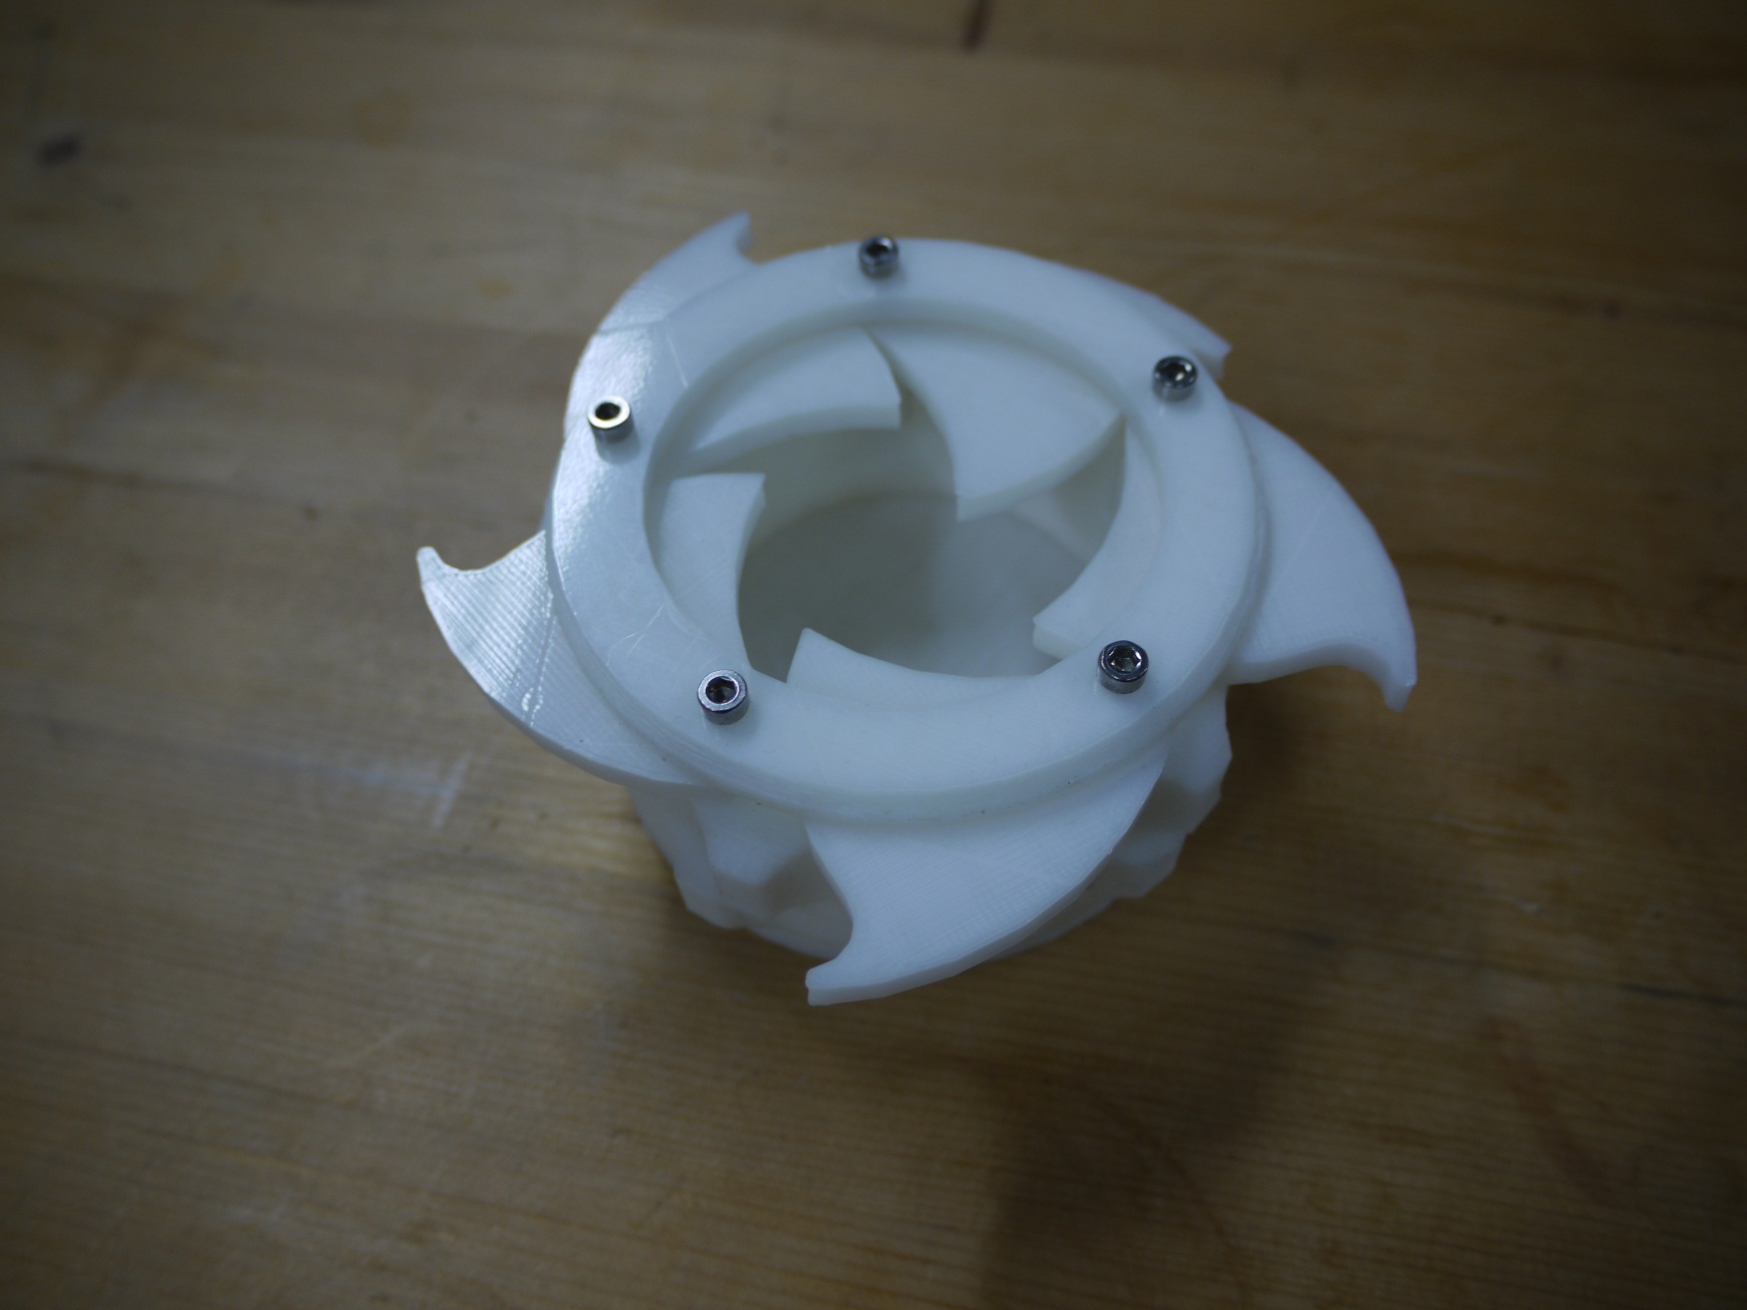

Engineered Pieces

Slide 20
Builders
What do you think you will use your Mendel90 3D printer for?

Slide 21
I think that you all know
Chris makes things in plastic
Now you will be able to do it
We think it is fantastic!

Slide 22
Any Questions?

